Slide 1
Unit 2 Process Management
By - Varsha R.Dange

Slide 2
Content
Process management: Process Concept, Process States: 2, 5, 7 state models, Process Description, Process Control,
Multithreading models, Thread implementations – user level and kernel level threads,
Concurrency: Issues with concurrency, Principles of Concurrency,
Mutual Exclusion: OS/Programming Language Support: Semaphores, Mutex,
Classical Process Synchronization problems

Slide 3
Process Concept, Process States, Process Description
We will see--
How are processes represented and controlled by the OS.
Process states which characterize the behavior of processes.
Data structures used to manage processes.

Slide 4
How are processes represented and controlled by the OS?

Slide 5
What is a Process?
A process is a program in execution
For execution ,process needs the computer resources like memory and IO resource.
Imagine a program written in C –my_prog.c.
After compilation we’ll get an executable file
If we now give a command like ./a.out, it becomes a process.

Slide 6
Process Concept
An operating system executes a variety of programs :
Batch system–jobs
Time-shared systems–user programs or tasks
Process is comprised of :
Program code (possibly shared)
A set of data
A number of attributes describing the state of the process

Slide 7
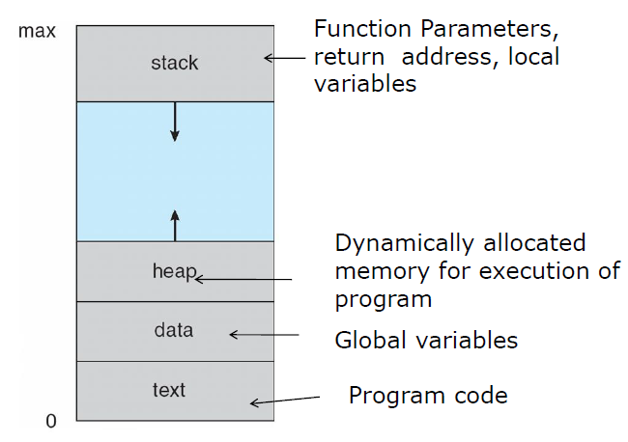
Process in memory
A program can be divided into four pieces when put into memory to become a process: stack, heap, text, and data.
Here, the arrows represent that both the Heap and the Stack can grow depending on the dynamic memory allocation and variables / functions.
Components of process

Slide 8
stack
Temporary data like method or function parameters, return address, and local variables are stored in the process stack.
Heap
This is the memory that is dynamically allocated to a process during its execution.
Text
It stores the machine code of the compiled program.
Data
The global as well as static variables are included in this section.

Slide 9
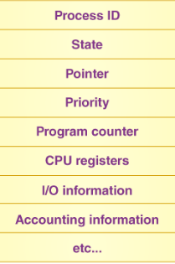
Process Control Block (PCB)
Every process has a process control block, which is a data structure managed by the operating system.
An integer process ID (or PID) is used to identify the PCB.
PCB stores all of the information (attributes) required to maintain track of a process
different operating systems may include different information.

Slide 10
Process state
The process’s present state, such as whether it’s ready, waiting, running, or whatever.
Process priority
This is required in order to grant or deny access to system resources.
Process ID
Each process in the OS has its own unique identifier.
Pointer
It refers to a pointer that points to the parent process.
Program counter
The program counter refers to a pointer that points to the address of the process’s next instruction.
CPU registers
Processes must be stored in various CPU registers for execution in the running state.

Slide 11
CPU scheduling information
Process priority and additional scheduling information are required for the process to be scheduled.
Memory management information
This includes information from the page table, memory limitations, and segment table, all of which are dependent on the amount of memory used by the OS.
Accounting information
This comprises CPU use for process execution, time constraints, and execution ID, among other things.
IO status information
OS also maintain the list of all open devices which are used during the execution of the process.
List of open files
During the Execution, Every process uses some files which need to be present in the main memory. OS also maintains a list of open files in the PCB..

Slide 12
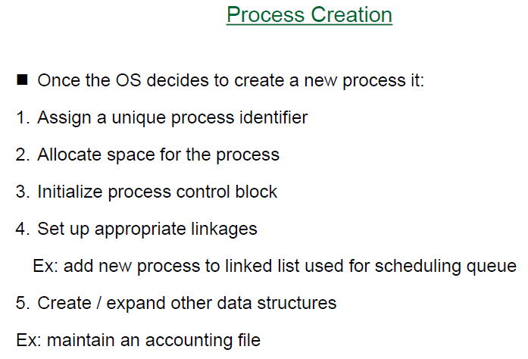

Slide 13
Process states which characterize the behavior of processes.

Slide 14
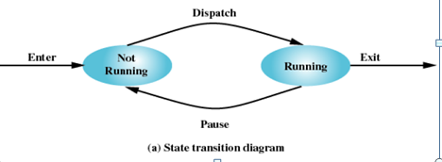
Two-State Process Model
A process goes through different states in its entire lifecycle.
Running: The process is currently being executed by the CPU.
Not Running: The process is not currently being executed. This state encompasses everything that is not running, such as waiting for I/O, ready to run but waiting for CPU time, etc.

Slide 15
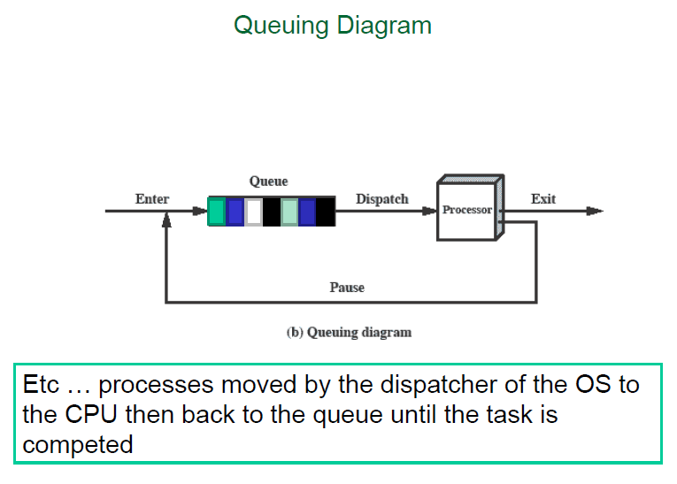

Slide 16
Process Termination
There must be some way that a process can indicate completion.
This indication may be :
A HALT instruction generating an interrupt alert to the OS.
A user action (e.g. log off, quitting an application)
A fault or error
Parent process terminating

Slide 17
Problems with two state model?
The 2-state model combines all non-running processes into one state, making it difficult to manage processes that are waiting for different reasons (e.g., I/O completion vs. ready to run).
The 5-state model introduces distinct states like Ready, Blocked, and New, which allows the OS to handle processes more precisely and efficiently.

Slide 18
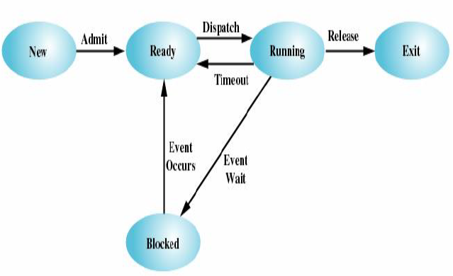
A Five-State Model
Running
Ready
Blocked
New
Exit

Slide 19
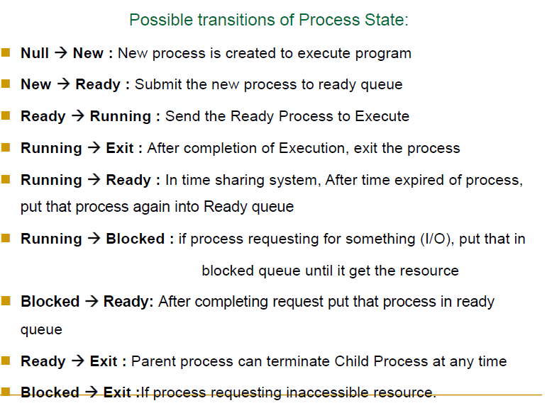

Slide 20
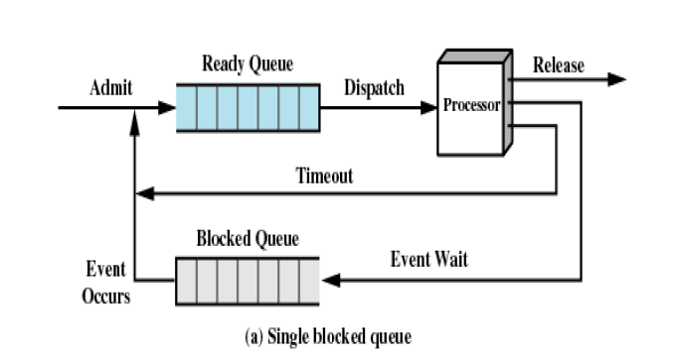
Using Two Queues

Slide 21
Components:
Ready Queue: This queue holds all the processes that are ready to be executed by the CPU but are waiting for their turn.
Blocked Queue: This queue holds all the processes that are currently waiting for some event to occur (e.g., I/O completion).
Processor: The CPU that executes the processes.
Transitions:
Admit: When a new process is created, it is admitted into the Ready Queue.
Dispatch: The process is selected from the Ready Queue and dispatched to the Processor for execution.
Release: After the process has finished execution, it is released (terminated).
Timeout: If a running process exceeds its allocated time slice, it is moved back to the Ready Queue to wait for another turn.
Event Wait: If a process requires an event (such as I/O completion), it is moved from the Processor to the Blocked Queue to wait for the event.
Event Occurs: When the event the process is waiting for occurs, the process is moved from the Blocked Queue back to the Ready Queue.

Slide 22
Suspended Processes
Processor is faster than I/O so all processes could be waiting for I/O
Swap these processes to disk to free up more memory
Blocked state becomes suspend state when swapped to disk
This leading to the introduction of new states:
Ready/Suspend: The process is ready but currently in secondary storage.
Blocked/Suspend: The process is waiting for an event and is in secondary storage.

Slide 23
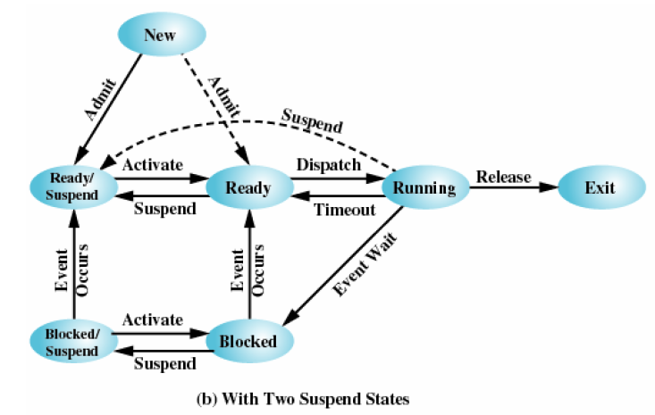
A seven state model

Slide 24
Data structures used to manage processes

Slide 25
data structures used for process management:
Process Control Block (PCB)
Ready Queue
Blocked Queue
Process table: The process table is a collection of PCBs.

Slide 26
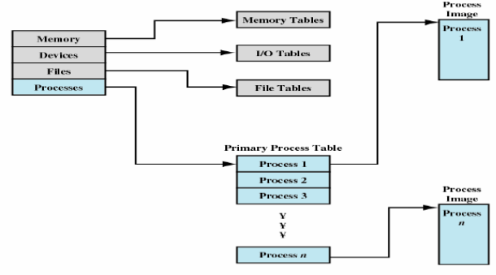
Process table

Slide 27
Control structures
Memory tables: are used to keep track of both main memory and secondary memory.
-Part of main memory is reserved for use by the operating system;
The memory tables generally include the following information:
– the allocation of main memory to processes
– the allocation of secondary memory to processes
– protection attributes of blocks of main or virtual memory
2. I/O tables: are used by the operating system to manage I/O devices. They should record:
- the availability of each particular device
- the status of I/O operations relating to each device
- the location in main memory being used as the source or destination of the I/O transfer

Slide 28
Control structures
3. File tables: provides information about
- Existence of files
- Location on secondary memory
- Current Status
Attributes
4. Process table:
- To manage processes the OS needs to know details of the processes
- Current state
- Process ID
- Location in memory

Slide 29
Orphan Process
In Unix-like operating systems, processes are arranged in a hierarchical structure.
Each process is created by another process (the parent process) using system calls like fork().
When a parent process terminates before its child process, the child process becomes an orphan.
when a child process becomes an orphan, it is adopted by the init process (with PID 1).
Zombie Process
- A Zombie Process is a process that has terminated but still has an entry in the process table.
- This generally occurs when the parent process needs to read the child process's exit status before the child process can be removed from the table

Slide 30
Multithreading models, Thread implementations
– user level and kernel level threads,

Slide 31

Multithreading in OS
A thread is a lightweight process that can be managed independently by a scheduler.
Thread is tiny process.
In multi-threading, the same process or task can be done by the number of threads,
or we can say that there is more than one thread to perform the task in multithreading.
With the use of multithreading, multitasking can be achieved.
For example, in a browser, many tabs can be viewed as threads.
MS Word uses many threads - formatting text from one thread, processing input from another thread, etc.

Slide 32
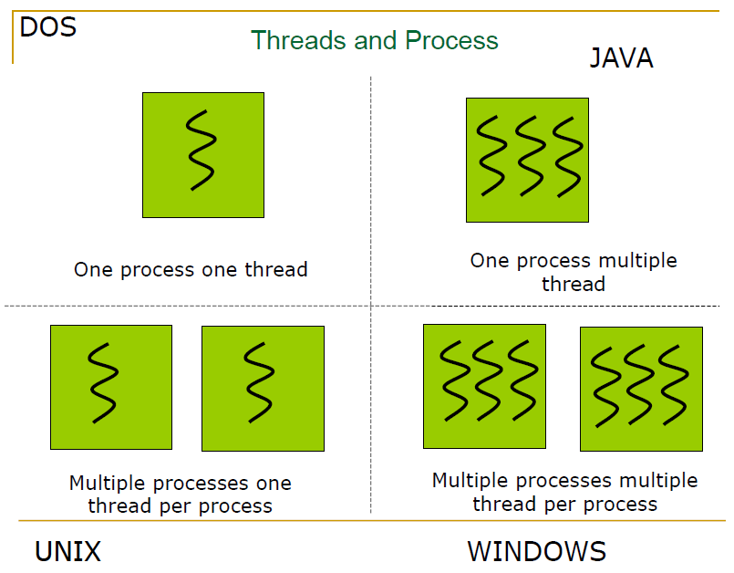

Slide 33
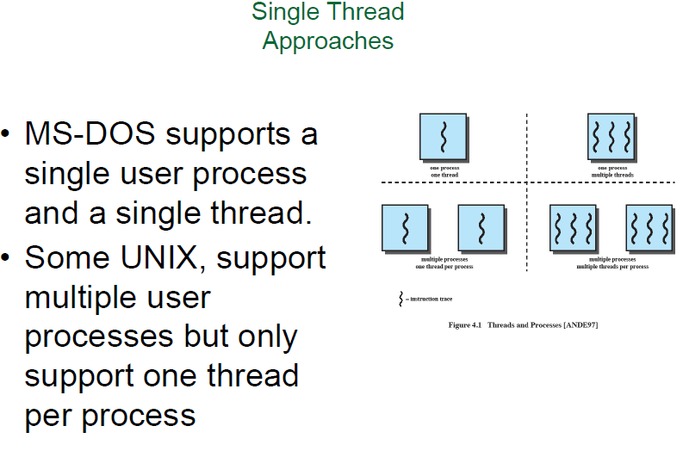

Slide 34
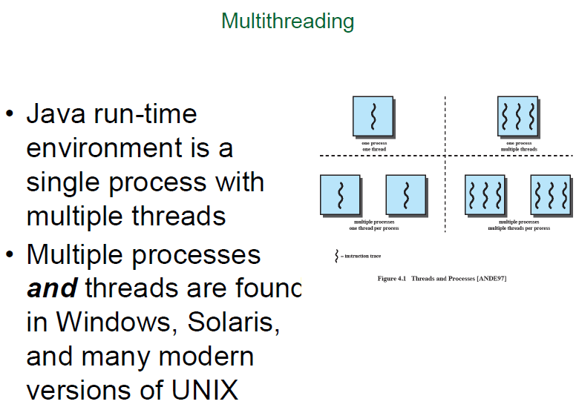

Slide 35
The threads of the same process share the following items during multithreading:
Address space
Global variables
Accounting information
Opened files, used memory and I/O
Child processes
Pending alarms
Signal and signal handlers

Slide 36
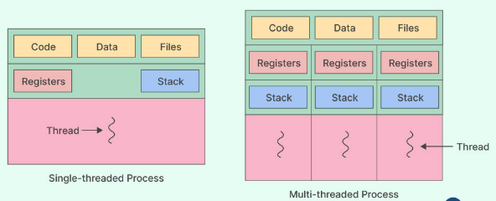
The following things are private (not shared) to the individual thread of a process in multithreading.
A thread shares information like data segment, code segment files etc. with its peer threads while it contains its own registers, stack, counter etc.
Stack (parameters, temporary, variables return address, etc)
TCB (Thread Control Block): It contains 'thread ids', 'CPU state information' (user-visible, control and status registers, stack pointers), and 'scheduling information' (state of thread priority, etc.)

Slide 37
Types of Threads
In an operating system, threads are divided into
user-level thread and
the Kernel-level thread.

Slide 38
User-level threads: (UTL)
Process threads are handled at the user level.
The kernel is unaware of user-level threads.
Execution of user-level thread scheduling by thread library (user mode).
Kernel-level threads: (KTL)
Also known as kernel-supported threads or lightweight processes.
Process threads are handled at the kernel level.
Kernel level threads are known to the kernel and
are scheduled by the operating system (Kernel-mode)

Slide 39
Difference
SrNo | User Level | Kernel Level
1 | Users implement the user-level threads. | the OS implements kernel-level threads.
2 | Managed by user level libraries | Managed by OS
3 | faster | slower
4 | Context switching fast | Context switching slow
5 | Java threads and POSIX threads. | Windows and Solaris.
6 | If one user level thread is blocked entire process get blocked | If one kernel level thread is blocked , no effect on others

Slide 40
Types of multithreading models
Modern operating systems support kernel thread and user thread in a combined way.
Many to many multithreading model.
Many to one multithreading model.
one to one multithreading model.

Slide 41
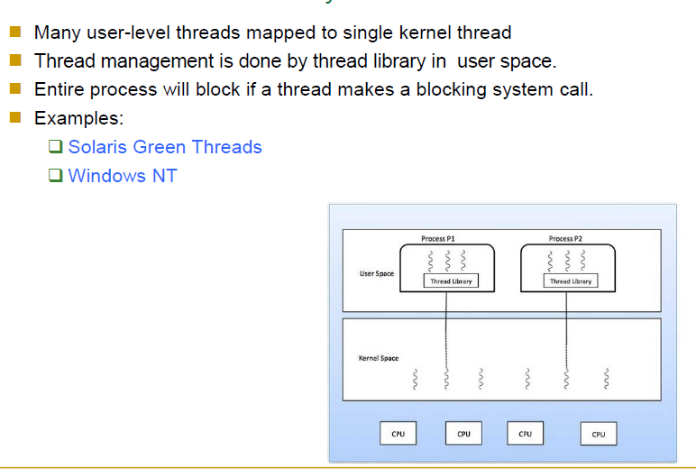
Many to one multithreading model:

Slide 42
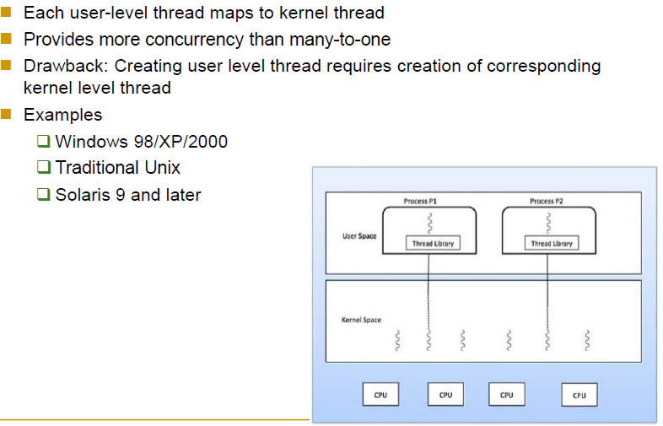
One to one multithreading model:

Slide 43
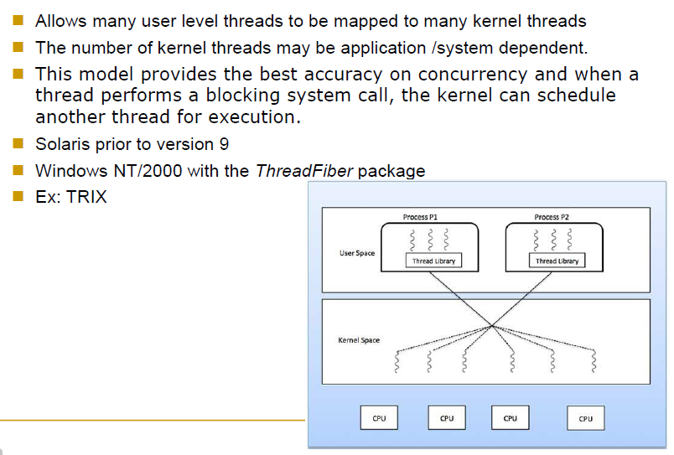
Many to Many multithreading model:

Slide 44
Thread Libraries
Three main thread libraries are in use today: POSIX Pthreads,
Windows, and Java.
Pthreads, the threads extension of the POSIX standard, may be provided as either a user-level or a kernel-level library.
The Windows thread library is a kernel-level library available on Windows systems.
The Java thread API allows threads to be created and managed directly in Java programs.

Slide 45
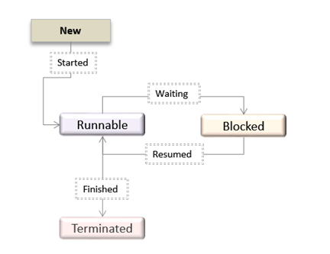
Thread State diagram

Slide 46
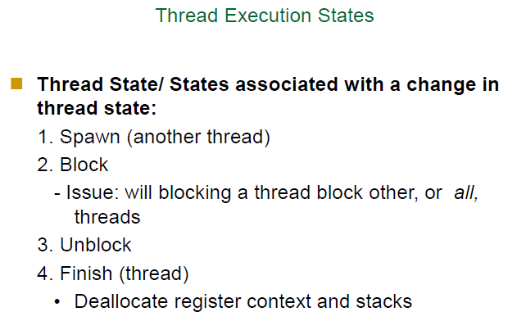

Slide 47
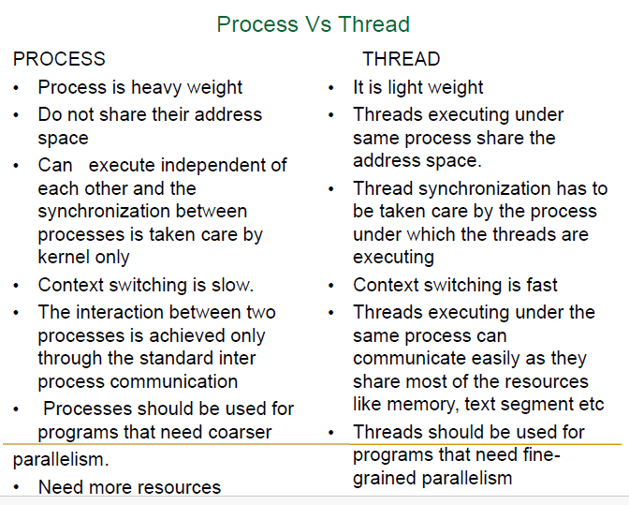

Slide 48
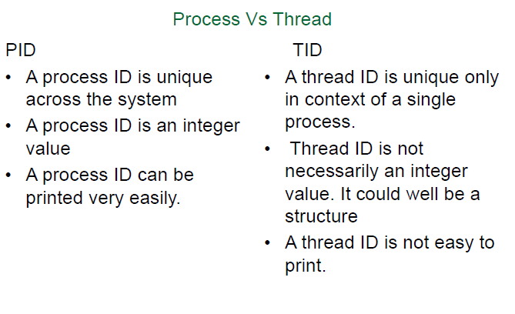

Slide 49
POSIX -#include <pthread.h> Thread: A lightweight process that runs concurrently with other threads within the same program. Threads share the same memory space but have separate stacks.
pthread_t: This is the data type used to declare a thread identifier in C.
pthread_create: This function is used to create a new thread.
pthread_join: This function waits for a specific thread to finish execution.
pthread_exit: This function is called by a thread to terminate its execution.
pthread_mutex_t: A mutex is used to ensure that only one thread can access a resource (like a variable or memory) at a time, avoiding race conditions.

Slide 50
Syntax: pthread_create(pthread_t *thread, const pthread_attr_t *attr, void *(*start_routine)(void *), void *arg);
attr is usually NULL for default attributes.
start_routine is the function that the thread will execute.
arg is the argument passed to the thread function.
Syntax: pthread_join(pthread_t thread, void **retval);
**retval: This is a pointer to a pointer where the exit status of the thread will be stored.
If you don't care about the return value of the thread, you can pass NULL.
If you do want to capture the return value, you pass the address of a void* variable.

Slide 51
#include <stdio.h>
#include <pthread.h>
// Function to be executed by the thread
void* thread_function(void* arg) {
printf("Hello from the thread!\n");
return NULL;
}
int main() {
pthread_t thread; // Declare a thread identifier
// Create the thread
pthread_create(&thread, NULL, thread_function, NULL);
// Wait for the thread to finish
pthread_join(thread, NULL);
printf("Thread has finished execution.\n");
return 0;
}
Example 1: Thread creation
Output:
Hello from the thread!
Thread has finished execution.

Slide 52
#include <stdio.h>
#include <pthread.h>
// Thread function definition
void* thread_function(void* arg) {
int* num = (int*)arg; // Cast the void* to the appropriate type
printf("Thread received value: %d\n", *num);
return NULL;
}
int main() {
pthread_t thread;
int value = 42;
// Create a thread and pass the address of `value` as the argument
pthread_create(&thread, NULL, thread_function, &value);
// Wait for the thread to finish
pthread_join(thread, NULL);
return 0;
}
Example 2: Thread creation
Output:
Thread received value: 42

Slide 53
#include <stdio.h>
#include <pthread.h>
// Function to be executed by each thread
void* thread_function(void* arg) {
int thread_number = *((int*)arg);
printf("Hello from Thread %d!\n", thread_number);
return NULL;
}
int main() {
pthread_t thread1, thread2; // Declare thread identifiers
int thread_arg1 = 1;
int thread_arg2 = 2;
// Create the first thread
pthread_create(&thread1, NULL, thread_function, &thread_arg1);
// Create the second thread
pthread_create(&thread2, NULL, thread_function, &thread_arg2);
// Wait for both threads to finish
pthread_join(thread1, NULL);
pthread_join(thread2, NULL);
printf("Both threads have finished execution.\n");
return 0;
}
Example 3: Threads creation
Output:
Hello from Thread 1!
Hello from Thread 2!
Both threads have finished execution.

Slide 54
#include <stdio.h>
#include <pthread.h>
#define NUM_THREADS 2 // Define the number of threads
// Function to be executed by each thread
void* thread_function(void* arg) {
int thread_number = *((int*)arg);
printf("Hello from Thread %d!\n", thread_number);
return NULL;
}
int main() {
pthread_t threads[NUM_THREADS]; // Array to hold thread identifiers
int thread_args[NUM_THREADS]; // Array to hold thread arguments
// Create threads using a for loop
for (int i = 0; i < NUM_THREADS; i++) {
thread_args[i] = i + 1; // Set the thread argument (1, 2, ...)
pthread_create(&threads[i], NULL, thread_function, &thread_args[i]);
}
// Wait for all threads to finish
for (int i = 0; i < NUM_THREADS; i++) {
pthread_join(threads[i], NULL);
}
printf("All threads have finished execution.\n");
return 0;
}
Example 4: Threads creation (using for loop)
Output:
Hello from Thread 1!
Hello from Thread 2!
Both threads have finished execution.

Slide 55
#include <stdio.h>
#include <pthread.h>
// Thread function
void* thread_function(void* arg) {
printf("Thread is running...\n");
return NULL;
}
int main() {
pthread_t thread;
// Create a thread
pthread_create(&thread, NULL, thread_function, NULL);
// Wait for the thread to finish
pthread_join(thread, NULL);
printf("Thread has finished execution.\n");
return 0;
}
Example 1: Without Capturing Return Value
Output:
Thread is running... Thread has finished execution.

Slide 56
#include <stdio.h>
#include <pthread.h>
// Thread function
void* thread_function(void* arg) {
printf("Thread is running...\n");
return (void*) "Thread finished successfully!";
}
int main() {
pthread_t thread;
void* thread_return_value;
// Create a thread
pthread_create(&thread, NULL, thread_function, NULL);
// Wait for the thread to finish and capture its return value
pthread_join(thread, &thread_return_value);
// Use the return value from the thread
printf("Thread has finished execution. Return value: %s\n", (char*)thread_return_value);
return 0;
}
Example 2: Capturing Return Value
Output:
Thread is running...
Thread has finished execution. Return value: Thread finished successfully!

Slide 57
Concurrency in Operating System
It refers to the execution of multiple instruction sequences at the same time.
Concurrency gives impression of simultaneous execution
These threads can interact with one another via shared memory or message passing.
Concurrency results in resource sharing, which causes issues like deadlocks and resource starvation(scarcity).

Slide 58

Parallelism
- In multiprocessor ,multiple processes are running simultaneously on different processor
Concurrency
- Parallelism is implemented on uni-processor , by interleaving operations
CPU P1 P2
IO P2 P1
Dual core processor
PE1
PE2

Slide 59
The Processes executing in the OS is one of the following two types:
Concurrent process
Independent process
Cooperating process
Independent Processes
Its state is not shared with any other process.
The result of execution depends only on the input state.
The result of the execution will always be the same for the same input.
The termination of the independent process will not terminate any other.
Cooperating System
Its state is shared along other processes.
The result of the execution depends on relative execution sequence and cannot be predicted in advanced(Non-deterministic).
The result of the execution will not always be the same for the same input.
The termination of the cooperating process may affect other process.

Slide 60
Principles of Concurrency
The principle of concurrency in operating systems involves managing multiple tasks simultaneously. Key aspects include:
Multitasking: Running multiple processes seemingly at the same time.
Context Switching: Switching the CPU between processes efficiently.
Process Synchronization: Ensuring processes don’t interfere with each other when accessing shared resources.
Deadlock Handling: Preventing or managing situations where processes get stuck waiting on each other.
Inter-process Communication (IPC): Allowing processes to exchange data and coordinate actions.

Slide 61
The amount of time it takes for a process to execute is not easily calculated, so we are unable to predict which process will complete first,
thereby allowing us to implement algorithms to deal with the issues that concurrency creates.
The amount of time a process takes to complete depends on the following:
The activities of other processes
The way operating system handles interrupts
The scheduling policies of the operating system

Slide 62
Advantages of Concurrency
Advantages
1. Improved Performance:
Concurrency enhances system performance by effectively utilizing available resources. With multiple tasks running concurrently, the CPU, memory, and I/O devices are continuously engaged, reducing idle time and maximizing overall throughput.
2. Better Resource Utilization
It enables resources that are not being used by one application to be used by another.
3. Running Multiple Applications
It enables you to execute multiple applications simultaneously.

Slide 63
Disadvantages of Concurrency
Disadvantages
When concurrency is used, required to protect multiple processes/threads from one another.
Concurrency requires to use extra techniques to coordinate multiple applications.
Sometimes running too many applications concurrently ,can severely degraded the performance.

Slide 64
Problems in Concurrency
Problems refer to the fundamental challenges or difficulties that arise when trying to implement or manage concurrency in a system.
Sharing global resources
When two or more processes (or threads) access and modify a shared global variable, the order of execution matters. If these processes do not properly synchronize, it can lead to inconsistent or unexpected results.
Optimal allocation of resources
Problem: Managing resources such as CPU time, memory, or I/O devices between multiple processes is complex. The operating system has to decide how to allocate these resources efficiently, which becomes more challenging as the number of concurrent processes increases.
Example: Consider a situation where several processes are waiting for a printer:
Process A is printing a large document.
Process B needs the printer for a single-page document.
If the operating system allocates the printer to Process A first, Process B has to wait, leading to inefficiency, especially if Process A takes a long time. An optimal allocation would involve prioritizing Process B to minimize overall waiting time.

Slide 65
Problems in Concurrency
3. Locating Programming Errors
Problem: Errors in concurrent programs are hard to find because they often depend on the specific timing of events, making them difficult to reproduce.
Example: Suppose you have a multithreaded program that occasionally crashes due to a race condition, where two threads are trying to update a shared resource at the same time.
- The error might only occur under specific conditions, such as high CPU load or when both threads reach a certain point in their execution simultaneously.
- Reproducing this exact scenario for debugging is difficult
4. Locking the channel:
It may be inefficient for the operating system to simply lock the channel and prevents its use by other processes.

Slide 66
Issues of Concurrency
Issues refer to the practical challenges, complications, or bugs that can arise running concurrent processes.
Deadlock: It occurs when two processes are blocked and hence neither can proceed to execute.
Example: Suppose Process A holds Resource 1 and requests Resource 2, while Process B holds Resource 2 and requests Resource 1. Neither process can proceed, leading to a deadlock.
Starvation: It occurs when a process does not obtain service to progress.
Example: In a scheduling system where a high-priority task keeps getting CPU time, a lower-priority task might never get a chance to run, leading to starvation.

Slide 67
Issues of Concurrency
3. Blocking : A process that is blocked is one that is waiting for some event, such as a resource becoming available or the completion of an I/O operation.
Long Wait Times: If a process is blocked for a long time, it can’t do anything else during that period. For
Example: if a process is waiting for user input from a terminal, it’s just sitting there, doing nothing until the user responds.
Race condition : A race condition occurs when multiple processes or threads access shared resources without proper synchronization (synchronization means systematic sharing of resources).
- The outcome of a process depends on order of execution
Example: Consider two threads trying to update a shared variable value.
If both threads read the value at the same time, calculate the new value, and then write it back

Slide 68
If both the process are concurrent processes, running on
Uni processor then :
int shared=5;
P0: P1
int X=shared; int Y=shared;
X++; Y--;
sleep(1); Sleep(1);
shared=X; shared=Y;
final correct result has to be: shared=5

Slide 69
P0 will write the value as 6
P1 will write the value as 4
Both are incorrect.
This is race condition problem
concurrent processes are racing to access shared resources

Slide 70
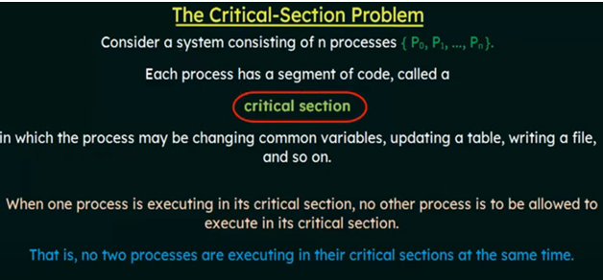
Critical section problem

Slide 71
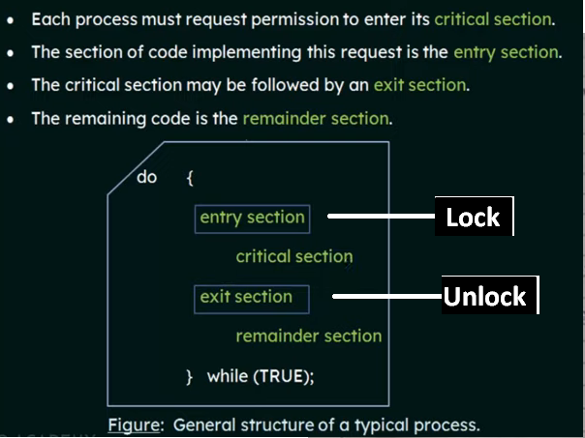
Rules for accessing critical section

Slide 72
Criteria for solution
A solution to the critical section problem must satisfy the following 3 requirements:
1. Mutual Exclusion
Mutual exclusion is a principle that ensures only one process or thread can access a critical section of code at a time
2. Progress:
if no process is currently in the critical section and some processes want to enter, then one of the waiting processes must be allowed to enter the critical section. (Guarantees that someone will move forward and get the chance to use the resource when it's available.) 3. Bounded Waiting:
Bounded waiting ensures that every process or thread that requests access to a critical section will eventually be granted access within a finite amount of time. This prevents indefinite postponement or starvation. (Ensures that no one waits forever; everyone gets a turn within a reasonable amount of time.)

Slide 73
synchronization mechanism/tool: semaphore
1. Semaphore-
is a synchronization tool in an operating system that helps manage how many processes can access a shared resource.
It used to solve critical section problem and to achieve process synchronization .
Semaphore is an integer variable or non- negative variable shared between threads .
It is accessed only through two standard atomic operations : wait() and signal()
Atomic means the operation has to be executed complete ,it can not be stop in between .
Eg-in wait() ,if we have 10 instructions then all 10 have to be executed .

Slide 74
Wait(or sleep or P ):
The Wait Operation is used to decide that the process can enter the critical state or wait for execution of process.
wait(S)
{
while (S<=0) ; //no operation
S- - ;
}
Decreases the semaphore value.
If s<=0 then no operation means process is in wait state
Else it decrement the value by one. when s=1 ,the can enter in c.s when s=0 ,then cant enter in c.s.

Slide 75
Signal(or wake-up or v):
The Signal Semaphore Operation is used to update the value of Semaphore.
signal(S)
{
S++;
}
Increases the semaphore value, signaling that a resource has been released. Other process can use critical section.
Using semaphore we can achieve mutual exclusion as:
do{
wait (mutex);
critical section
signal(mutex);
} while(1)
Here mutex=1

Slide 76
Types of Semaphores
Binary Semaphore
Counting semaphore
Binary Semaphore -
Here, only two values of Semaphore ,1 & 0.
If the Value of Binary Semaphore is 1, then the process can enter the critical section area.
If the value of Binary Semaphore is 0 then the process can not enter the critical section area.
Using this we can implement mutual exclusion.

Slide 77
if the value of the semaphore is 1, then process enter into the critical section,
the wait function would have decremented the value to 0 meaning that no more processes can access the critical section
Once the process exits the critical section, the signal operation is executed and the value of the semaphore is incremented by 1, meaning that the critical section can now be accessed by another process.

Slide 78
Counting semaphore –
can have a non-negative integer value, represents the number of available resources.
It can be incremented or decremented to indicate when a resource is available or in use.

Slide 79
synchronization mechanism/tools
2. Mutex
A mutex (MUTual EXclusion locks) is a synchronization mechanism
used to prevent multiple processes or threads from accessing a shared resource at the same time,
ensuring that only one process or thread can access the resource at any given moment.
prevents issues like race conditions

Slide 80
Basic Mutex Operations:
Lock (or acquire): A process attempts to lock the mutex before entering the critical section.
Unlock (or release): The process unlocks the mutex after exiting the critical section, allowing other processes to access the resource.

Slide 81
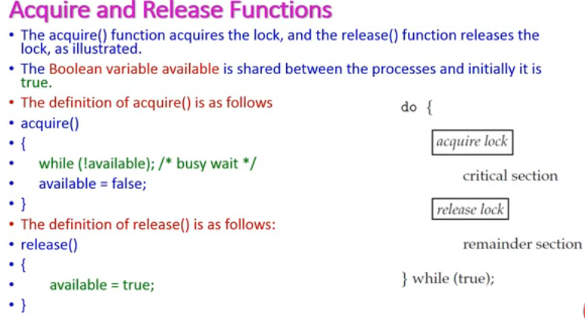
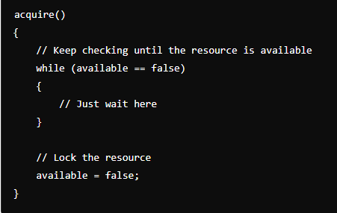
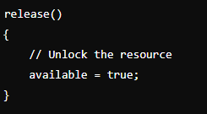

Slide 82
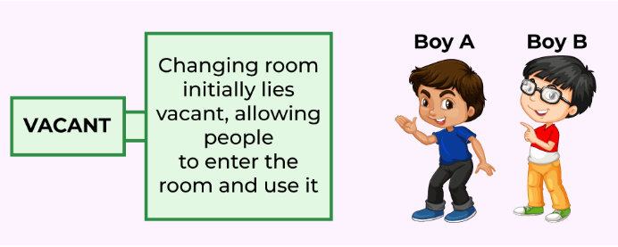
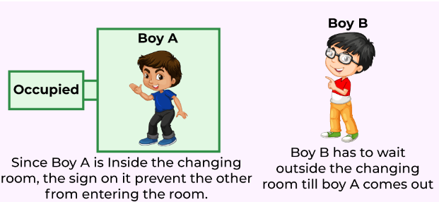
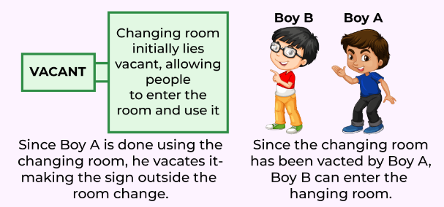
Mutual Exclusion

Slide 83
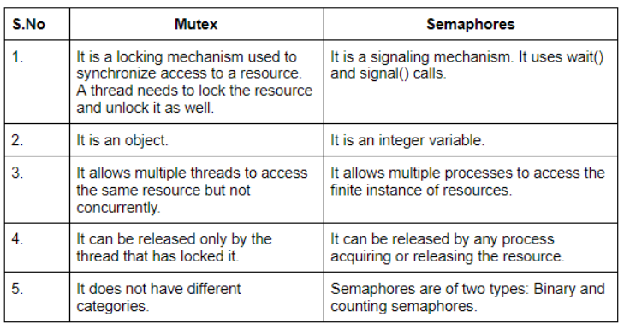
Difference between Mutex and Semaphore

Slide 84
in semaphore it allows multiple processes to access the finite instance of resource means ? In semaphore, allowing multiple processes to access a finite instance of a resource means that the semaphore controls access to a limited number of identical resources. The semaphore keeps track of how many instances of the resource are available, and multiple processes can access the resource as long as instances are available.
For example, if there are 3 printers (resources), and a semaphore is initialized with a value of 3, it means that up to 3 processes can access the printers simultaneously. Each time a process acquires a printer, the semaphore value decreases by 1. When the semaphore reaches 0, no more processes can acquire a printer until one is released (the semaphore value increases).

Slide 85
Classical synchronization problem
Producer - Consumer Problem
Readers - Writers Problem
Dining philosopher problem

Slide 86
Producer - Consumer Problem
Producer-Consumer problem is a classical synchronization problem in the operating system.
Also called bounded –buffer problem
With the presence of more than one process and limited resources in the system the synchronization problem arises.
If one resource is shared between more than one process at the same time then it can lead to data inconsistency.
In the producer-consumer problem, the producer produces an item/data and the consumer consumes the item/data produced by the producer.

Slide 87
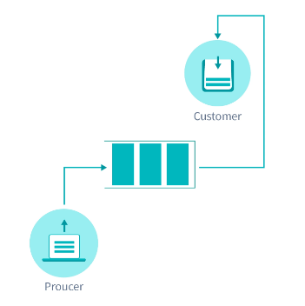
Both Producer and Consumer share a common memory buffer .
buffer is a space of a certain size in the memory which is used for storage.
the producer produces the data into the buffer
the consumer consumes the data from the buffer.

Slide 88
What is Producer Consumer Problem?
Producer Process should not produce any data when the shared buffer is full.
Consumer Process should not consume any data when the shared buffer is empty.
The access to the shared buffer should be mutually exclusive i.e at a time only one process should be able to access the shared buffer and make changes to it.
For consistent data, synchronization between Producer and Consumer is required

Slide 89
Solution For Producer Consumer Problem: using semaphore
To solve the Producer-Consumer problem three semaphores/ variables are used :
Semaphores are variables used to indicate the number of resources available in the system at a particular time.
semaphore variables are used to achieve Process Synchronization by controlling the access .

Slide 90
Full ( is counting semaphore)
Keeps the track of space filled in the buffer by the Producer process.
initially set to 0 ,as no space is filled by the Producer process.
Empty ( is counting semaphore)
Keeps the track empty space in the buffer.
initially set to the BUFFER-SIZE, as the whole buffer is empty.
Mutex semaphore(is binary semaphore)
Mutex semaphore is used to achieve mutual exclusion.
mutex semaphore ensures that at any particular time only the producer or the consumer is accessing the buffer.
Mutex semaphore - mutex semaphore is a binary semaphore variable that has a value of 0 or 1,
1: critical section free ,
0 : not free
Signal() - The signal function increases the semaphore value by 1.
Wait() - The wait operation decreases the semaphore value by 1.

Slide 91



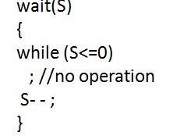
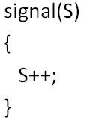
structure of Producer and Consumer
while (true){
wait(mutex);
wait(full);
//remove an item from buffer to nextconsume
signal(empty);
signal(mutex);
}
while (true){
//produce an item & put in nextproduced
wait(mutex);
wait(empty);
//add nextproduced in buffer
signal(full);
signal(mutex);
}

Slide 92
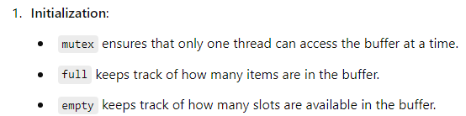
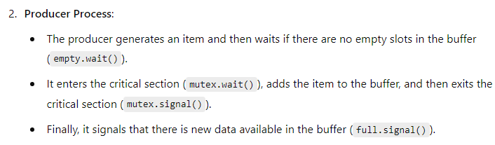
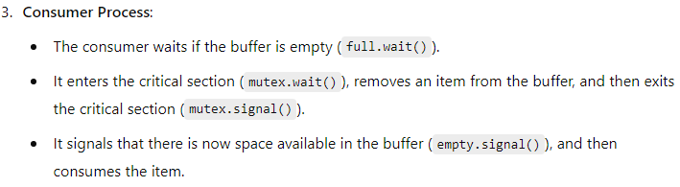

Slide 93
Producer-consumer problem using mutex
Mutex and Condition Variables − Mutex provide mutual exclusion to protect critical sections of code, while condition variables allow threads to wait for specific conditions to be met before proceeding.

Slide 94
Using condition variables and mutex
here count is shared variable and count = 0 initially, it is shows no. of items in the buffer. in = 0 ,out = 0
while (true){
//locks the buffer ,produce an item & put into nextproduced
while(count == buffer_size);
buffer[in] = nextproduced ;
in= (in + 1) % buffer_size;
count++;
//unlock
}
while (true){
//lock the buffer
while(count == 0);
nextcosumed =buffer[out] ;
out= (out + 1) % buffer_size;
count--;
//consume the item
}

Slide 95
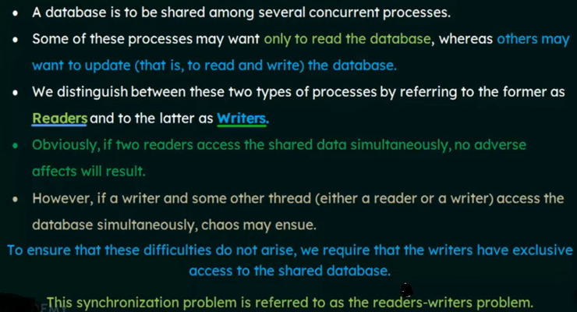
Readers-Writers Problem

Slide 96
Readers-Writers Problem
The readers-writers problem is a classical problem of process synchronization, it relates to a data set such as a file that is shared between more than one process at a time.
Among these various processes, some are Readers - which can only read the data set; they do not perform any updates, some are Writers - can both read and write in the data sets.
The readers-writers problem is used for managing synchronization among various reader and writer process so that there are no problems with the data sets, i.e. no inconsistency is generated.

Slide 97
What is The Readers-Writers Problem?
Readers: Multiple readers can access the shared data simultaneously without causing any issues because they are only reading and not modifying the data.
Writers: Only one writer can access the shared data at a time to ensure data integrity, as writers modify the data, and concurrent modifications could lead to data corruption or inconsistencies.
The challenge is to synchronize access in a way that maintains data integrity and avoids race conditions.

Slide 98
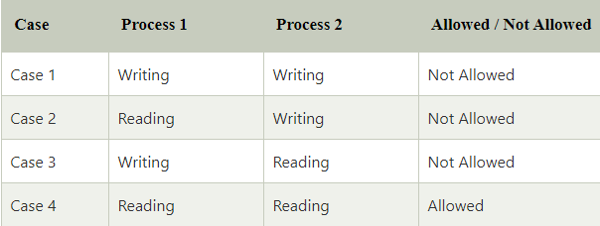

Slide 99
Criteria for Solution of the Reader-Writer Problem
First Reader-Writer Problem (No Starvation for Readers):
Multiple readers can read the shared resource simultaneously.
Writers need exclusive access to the resource, meaning no other readers or writers can access it while writing.
If a writer requests the resource, it must wait until all readers have finished.
Issue: Writers might face starvation since a continuous stream of readers can prevent writers from writing indefinitely.
Second Reader-Writer Problem (No Starvation for Writers):
Once a writer is ready, it must be given priority over new incoming readers.
Issue: Readers may face starvation if there are always writers ready to write.

Slide 100
Solution of the Reader-Writer Problem
The solution of readers and writers can be implemented using binary semaphores.
We use two binary semaphores "write" and "mutex", where binary semaphore can be defined as:
Shared data:
int readcount initialize to Counts the number of active readers.
mutex , a semaphore initialize to 1,which is ensure mutual exclusion when readcount is 1.
wrt , a semaphore ,initialize to 1, Controls access to the shared resource, ensuring mutual exclusion for writers.

Slide 101
Code for Writer Process
-------------------
Writer Process: wrt=1
-------------------
while(true)
{
wait(wrt);
// Critical Section - Writing to the shared resource Write to the shared resource
signal(wrt);
}

Slide 102
Code for Reader Process
-------------------
Reader Process: mutex = 1 , wrt = 1 , readcount = 0
-------------------
while(true)
{
wait(mutex);
readcount++;
if (readcount == 1)
wait(wrt);
signal(mutex)
// Critical Section - Reading the shared resource
wait(mutex)
readcount - -;
if (readcount == 0 )
signal(wrt)
signal(mutex)
}
entry section
critical section
exit section

Slide 103
Dining Philosophers Problem
Dining Philosophers Problem in OS is a classical synchronization problem
With the presence of more than one process and limited resources in the system the synchronization problem arises.
If one resource is shared between more than one process at the same time then it can lead to data inconsistency.
Dining Philosophers Problem shows the limitations of process synchronization for multiple processes and limited resources.

Slide 104

what is Dining Philosophers Problem
Constraints and Condition for the problem :
There are five philosophers sitting around a circular table.
Each philosopher alternates between two activities: thinking and eating.
In between each pair of philosophers, there is a single fork (five forks total).
A philosopher needs both forks (left and right) to eat but can only pick up one fork at a time.
The goal is to devise a synchronization mechanism that allows the philosophers to eat without causing:
Deadlock (where all philosophers are holding one fork and waiting forever for the other).
Starvation (where a philosopher never gets a chance to eat).

Slide 105


Slide 106
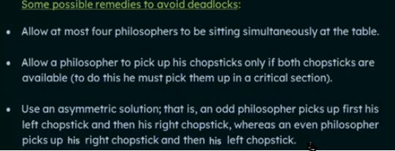
Potential Solutions to Avoid Deadlock:
Asymmetry
Resource Hierarchy

Slide 107
1. Asymmetry---How it Works:
If all philosophers attempt to pick up their left fork first and wait for their right fork, it can lead to deadlock (where all philosophers are waiting for a resource held by someone else).
By making Philosopher 0 pick up the right fork first, the cycle of waiting is broken, ensuring that at least one philosopher will always be able to pick up both forks and eat, which prevents deadlock.

Slide 108
Advantages:
Allows more concurrent eating when forks are available.
Simple to implement and efficient in practice.
Disadvantages:
Although it prevents deadlock, it does not prevent starvation—a philosopher could still end up waiting indefinitely if the scheduling is unfavorable.

Slide 109
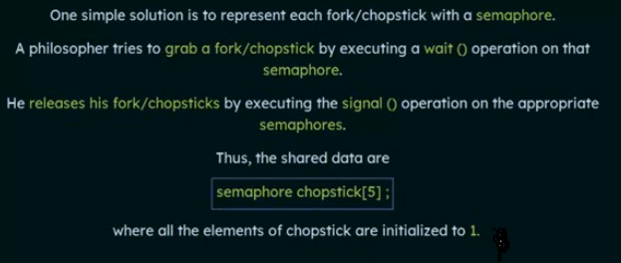

Slide 110
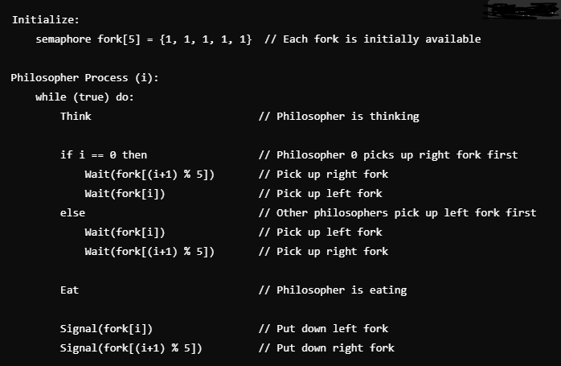
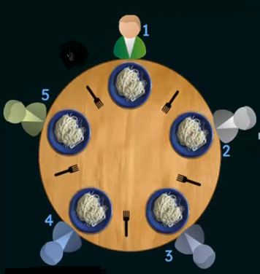
Pseudo code for Asymmetry Solution(Semaphore):
C5
C0
C1
C1
C4
C4
C2
C2
C3
C3

Slide 111
2. Resource Hierarchy Solution:
In the resource hierarchy solution, philosophers are forced to pick up both forks simultaneously by using a single mutex (lock) that controls access to the forks.
This ensures that only one philosopher at a time can attempt to pick up forks, preventing deadlock.

Slide 112
How it Works:
A global mutex lock is used to make sure that when a philosopher wants to eat, they acquire both forks at the same time (or none at all).
If the mutex is locked, the philosopher must wait until it is available, ensuring that no philosopher gets stuck holding one fork while waiting for the other, which prevents deadlock.

Slide 113
Advantages:
Ensures that deadlock cannot happen because a philosopher either acquires both forks or none.
Disadvantages:
Reduces concurrency—only one philosopher can eat at a time, which could lead to inefficient use of resources.
While it prevents deadlock, it still doesn't prevent starvation completely (if a philosopher is consistently denied access to the mutex).

Slide 114
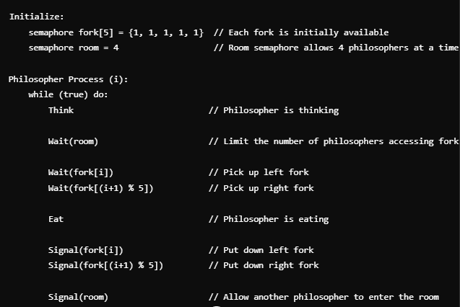
Pseudo code for Resource Hierarchy Solution:

